Slide 1

College Search Mania
Presentation By
Shubham Gaware
Roll no : 22219
Project Guide:
Prof. Kumudini Manwar

Slide 2
INTRODUCTION
Education portals or the college’s Search Engines are generally used by students or their parents to Search for the best and the right colleges around the world or in the country . These websites stores and maintains data about the colleges and universities including private and governments.
These Education portals offer the latest information on admissions, entrance tests, infrastructure, courses, and careers. The information covers Medical, Engineering, Management, Commerce, and law colleges.
India has over 300+ entrance examinations for students and has the most complex admission procedures with physical forms, documents & DDs.
With so many choices in hand, it’s very overwhelming for the students to pick the right college. There are tons of online resources and college search engines to conduct your college search that help students match up with the right colleges. A college search engine is the best place to start. It can help prospective college students, parents choose potential colleges. These websites aim to make college selection & admission simple by connecting students with colleges.
Get updated information regarding Seats , Cut off , and many more

Slide 3
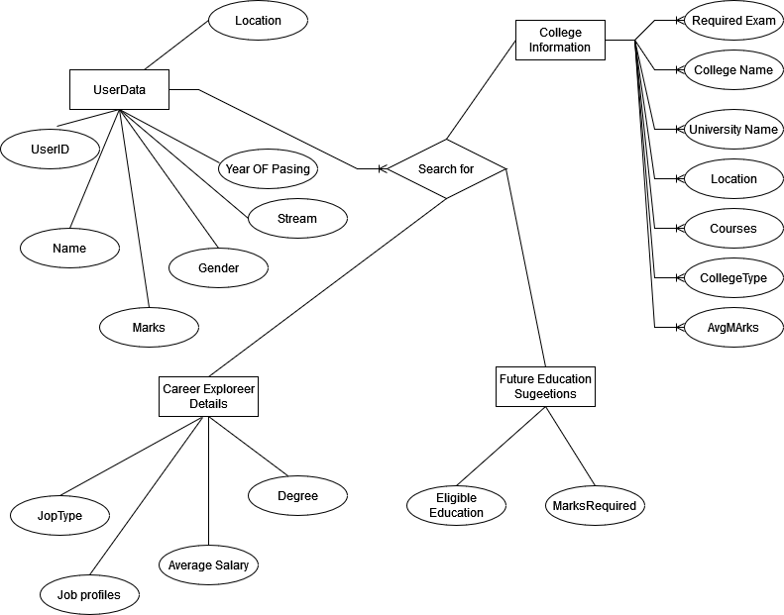
UML DIAGRAMS
1.ER Diagrams:

Slide 4
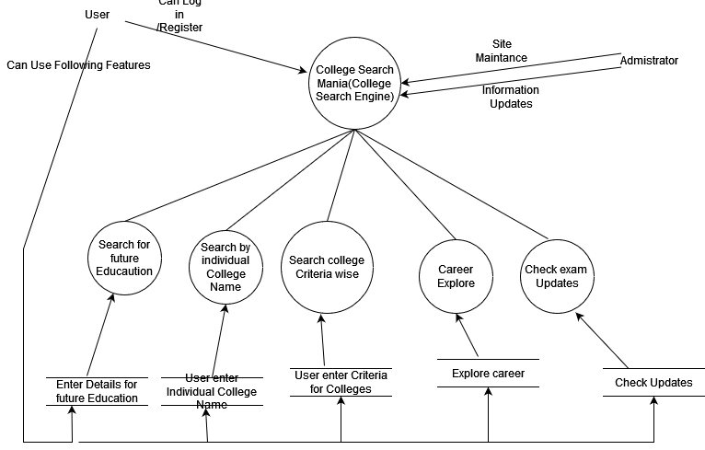
2.Data Flow Diagram(Context Level):

Slide 5
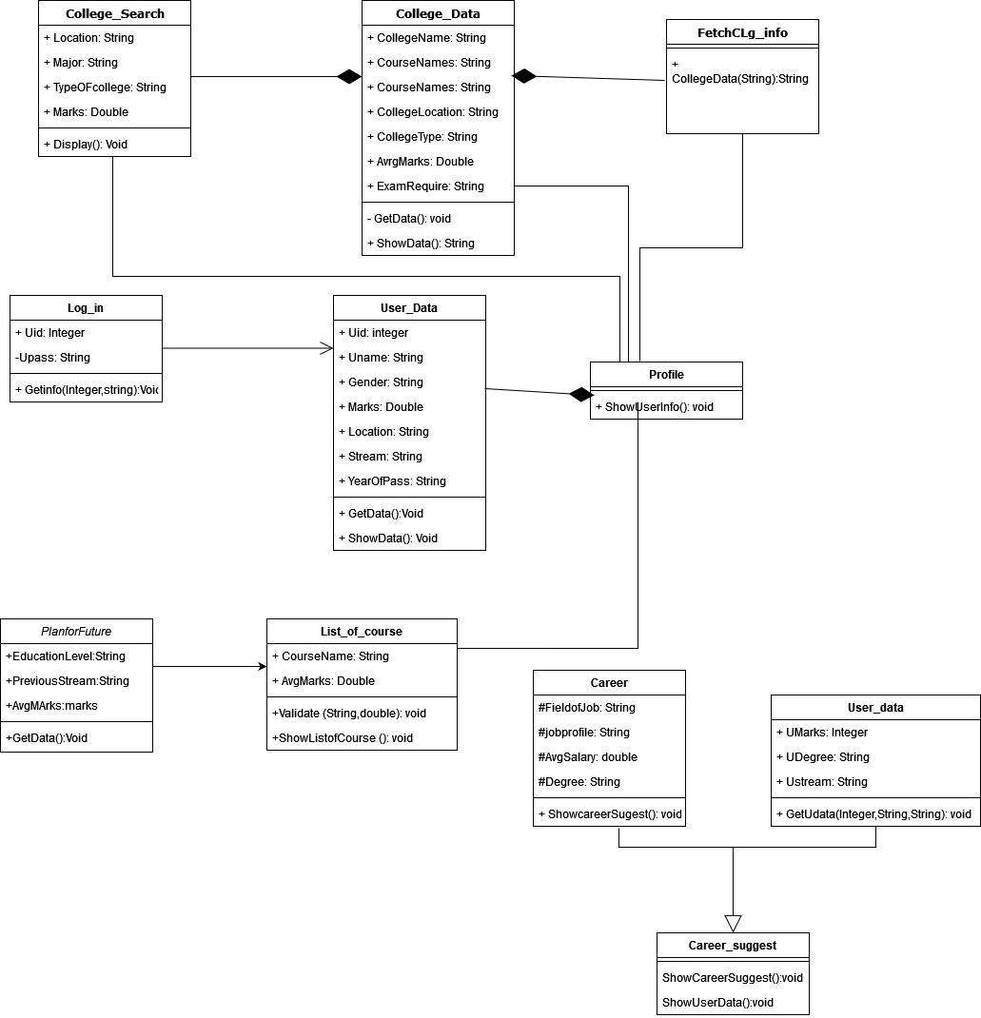
3.Class Diagrams

Slide 6
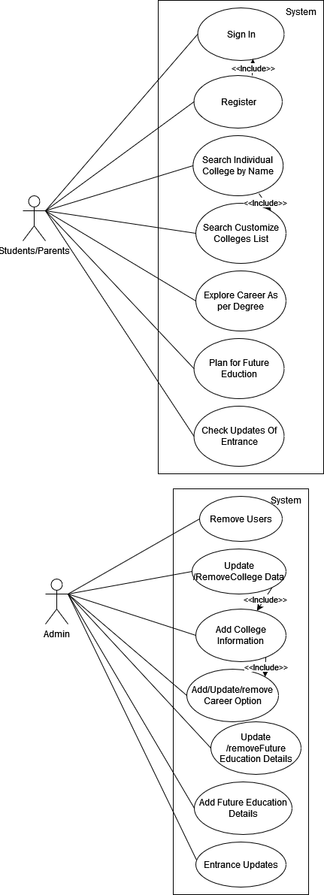
4.Use Case Diagram :

Slide 7
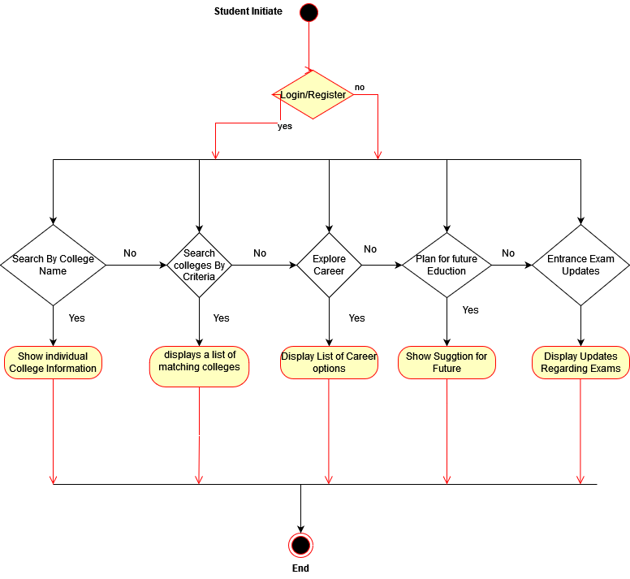
5.1.Activity Diagram For User

Slide 8
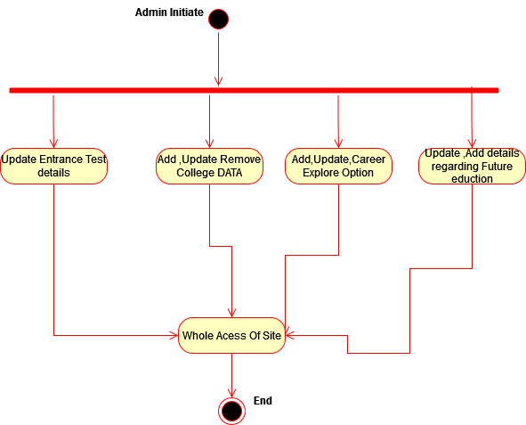
5.2.Acivity Diagram For Admin

Slide 9
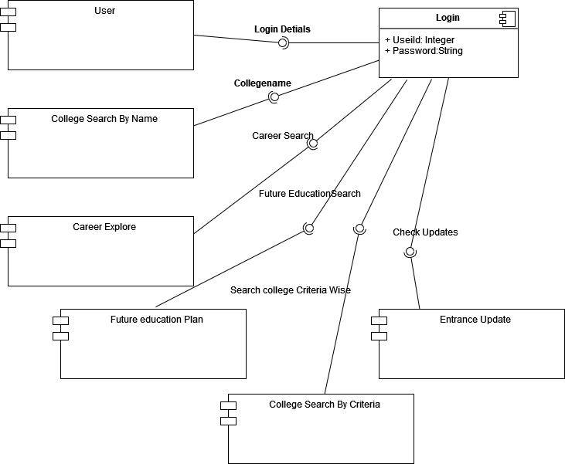
6.Component Diagram

Slide 10
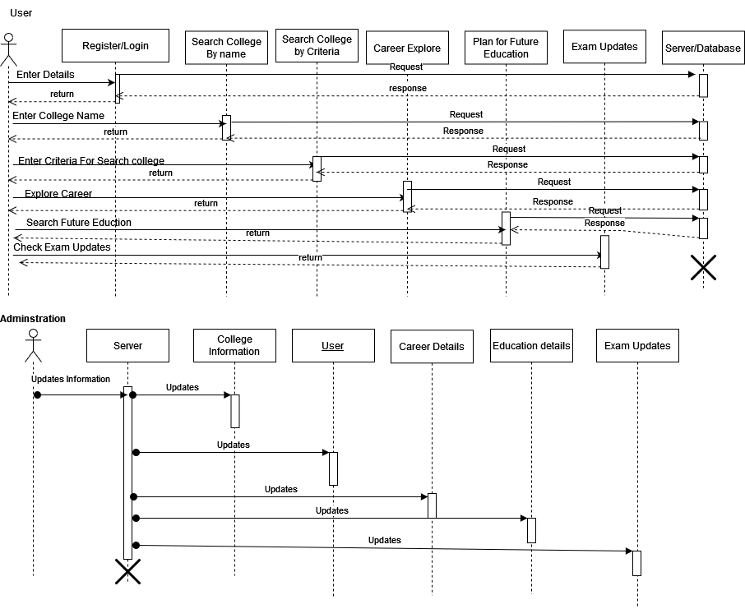
7.Sequence Diagram

Slide 11
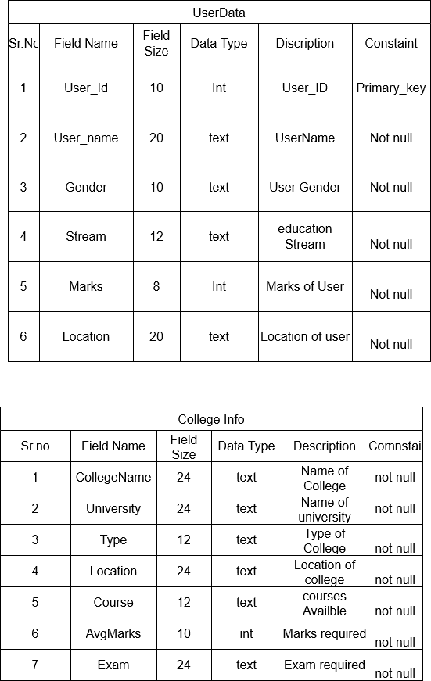
8.Tables For data

Slide 12
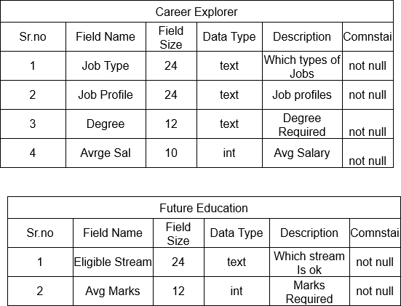
9.Tables For data

